Slide 1
Guide for IO Visor Environment
Jungi Lee
2017-07-24

Slide 2
Type S/C/O (현재 설정 상황)
Type | IP address | OS/Kernel Version
Type S | 116.89.190.193 | OA 4.2 (Ubuntu 14.04. based) Linux Kernel 4.8.0
Type C | 210.114.90.170 | Ubuntu 16.04 Linux Kernel 4.8.0
Type O | 210.114.90.169 | Ubuntu 16.04 Linux Kernel 4.8.0
Working
Working
Working

Slide 3
Upgrade to Linux Kernel 4.5.1 to 4.8.0 (On Type S)
wget http://kernel.ubuntu.com/~kernel-ppa/mainline/v4.8/linux-headers-4.8.0-040800_4.8.0-040800.201610022031_all.deb
wget http://kernel.ubuntu.com/~kernel-ppa/mainline/v4.8/linux-headers-4.8.0-040800-generic_4.8.0-040800.201610022031_amd64.deb
wget http://kernel.ubuntu.com/~kernel-ppa/mainline/v4.8/linux-image-4.8.0-040800-generic_4.8.0-040800.201610022031_amd64.deb
sudo dpkg -i linux-*.deb

Slide 4
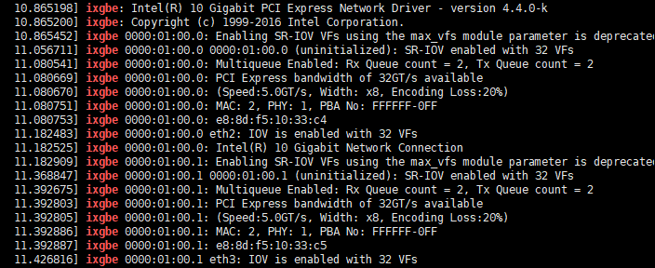
Type S 10G Driver Problem
커널 업그레이드가 진행되며 Parameter 관련 오류 발생
-> /etc/modprobe.d/ixgbe.conf 의 Parameter 수정해서 해결
(sudo insmod ixgbe.ko max_vfs=32)

Slide 5
Upgrade to Linux Kernel 4.4.0 to 4.8.0 (On Type C)
Sudo apt-get -y install linux-image-4.8.0-41-generic linux-image-extra-4.8.0-41-generic
sudo apt-get install linux-headers-$(uname -r)
CONFIG_BPF=y
CONFIG_BPF_SYSCALL=y
# [optional, for tc filters]
CONFIG_NET_CLS_BPF=m
# [optional, for tc actions]
CONFIG_NET_ACT_BPF=m
CONFIG_BPF_JIT=y
CONFIG_HAVE_BPF_JIT=y
# [optional, for kprobes]
CONFIG_BPF_EVENTS=y

Slide 6
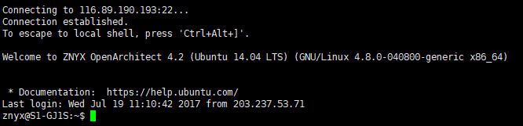
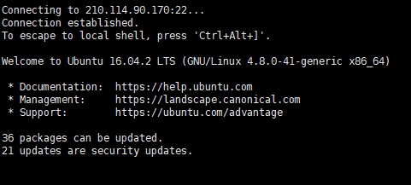
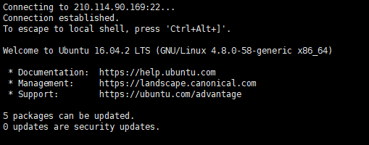
Type S/C/O kernel Version 4.8.0

Slide 7
Install IO Visor – Build Dependencies
# Trusty and older
VER=trusty
echo "deb http://llvm.org/apt/$VER/ llvm-toolchain-$VER-3.7 main
deb-src http://llvm.org/apt/$VER/ llvm-toolchain-$VER-3.7 main" | \ sudo tee /etc/apt/sources.list.d/llvm.list
wget -O - http://llvm.org/apt/llvm-snapshot.gpg.key | sudo apt-key add -
sudo apt-get update
# All versions
sudo apt-get -y install bison build-essential cmake flex git libedit-dev libllvm3.7 llvm-3.7-dev libclang-3.7-dev python zlib1g-dev libelf-dev

Slide 8
Install IO Visor – Install and compile BCC
git clone https://github.com/iovisor/bcc.git
mkdir bcc/build; cd bcc/build
cmake .. -DCMAKE_INSTALL_PREFIX=/usr
make
sudo make install

Slide 9
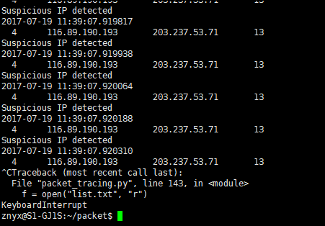
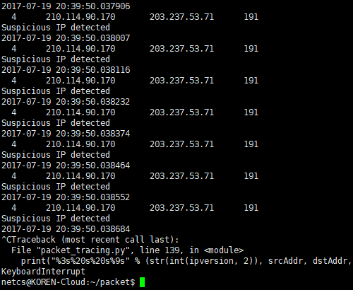
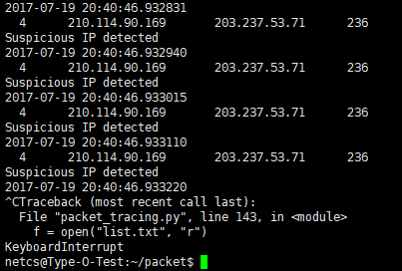
Packet tracing
$sudo python packet_tracing.py
Working on Type S/C/O

